Slide 1

You can’t have a clusterbleep without a cluster
Everyone has screwed up Kubernetes and no one is talking about it

Slide 2


Kris Nova
Senior Developer Advocate

Slide 3
Who here has never struggled with Kubernetes?

Slide 4
What does Kubernetes introduce?

Slide 5
Kubernetes introduces
resilience

Slide 6
Kubernetes introduces
efficiency

Slide 7
Kubernetes introduces
repeatability

Slide 8
Kubernetes introduces complexity

Slide 9
Kubernetes introduces
risk

Slide 10
What about the cloud?

Slide 11
Modern Cloud Computing:
Reselling electricity at a premium
Data Center
5 Volts
120/220 volts
Hardware
WAN
Network Interface
Storage
120/220 volts
Hardware
Optical
Storage
Users
120/220 volts
Hardware
Storage
Revenue

Slide 12
Modern Cloud Computing:
The Stack
Your Application
main(){}
Compute
Tools and Add ons
Network
Kubernetes
Storage
“OS”
OS? Virtualization?
“Hardware”
Hardware
Electricity

Slide 13
Kubernetes: Management
Your Application
Tools and Add ons
Kubernetes
OS? Virtualization?
Hardware
Electricity

Slide 14
Kubernetes: Management
Your Application
Other Kubernetes Clusters
Tools and Add ons
Other Kubernetes Clusters
Kubernetes
Other Kubernetes Clusters
OS? Virtualization?
Hardware
Electricity

Slide 15
Kubernetes: Internals
Control Plane
Node
Kubelet API Server
Scheduler
Kubelet
API Server
Controller Manager
etcd

Slide 16
Kubernetes: Internals
Control Plane
Node
Kubelet API Server
Scheduler
Kubelet
API Server
Controller Manager
CNI
etcd
DNS
Container Runtime
CNI
TLS
TLS
Container Runtime

Slide 17
Kubernetes: API
You
TLS Encrypted Rest API
Your Application
main(){}
Kubelet API Server
Scheduler
Tools and Add ons
Kubelet
API Server
Controller Manager
etcd
DNS
CNI
Kubernetes
“OS”
CNI
Container Runtime
OS? Virtualization?
“Hardware”
TLS
Container Runtime
TLS
Hardware
Electricity
Cloud?

Slide 18
Oh… Also containers don’t exist...
Synthetic System
namespaces
process (PID)
main(){}
main(){}
cgroup

Slide 19
Oh… Also containers don’t exist...
Synthetic System
namespaces
Images
process (PID)
main(){}
Image Registry
main(){}
CI / CD
cgroup
Host operating system

Slide 20
Kubernetes
You?
TLS Encrypted Rest API
namespaces
Images
process (PID)
Image Registry
main(){}
cgroup
CI / CD
Your Application
Host operating system
Kubelet API Server
Scheduler
Tools and Add ons
Kubelet
API Server
Controller Manager
Kubernetes
CNI
etcd
DNS
“OS”
OS? Virtualization?
CNI
Container Runtime
“Hardware”
TLS
Hardware
TLS
Container Runtime
Electricity
Cloud?

Slide 21
Does anybody have any questions?

Slide 22
Let’s look at a few clusterbleeps

Slide 23
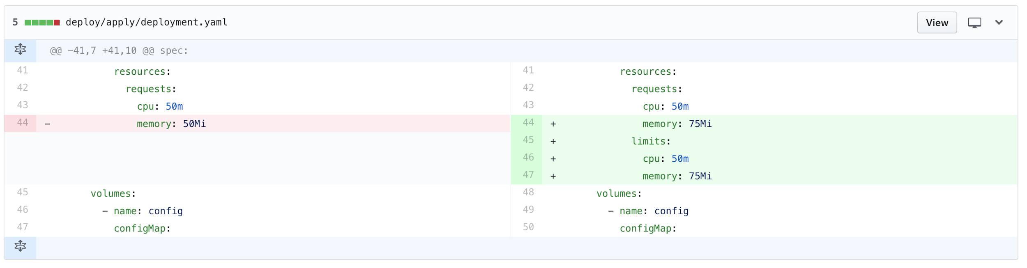

Once upon a time...

Slide 24
What Happened?
PR Merged
Authentication Service Failed
Entire System unable to Authenticate
New Container Image CI/CD
Incompatibility with new Go library
!
Deployment Rescheduled
Containers started

Slide 25
When Kubernetes bleeps up Kubernetes?

Slide 26
Simple Solution:
Harden CI/CD
Integration Testing

Slide 27
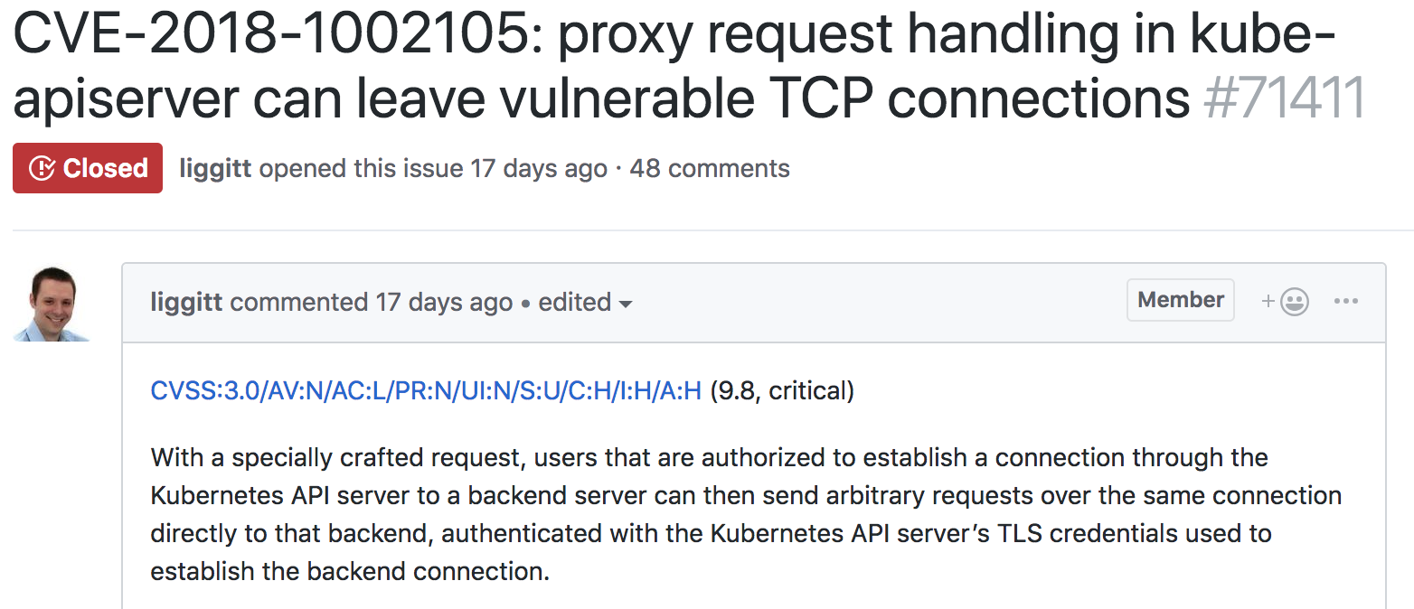
Notes:
CVSS
Common Vulnerability Scoring System

Slide 28
CVE-2018-1002105
Authenticated Request to Kubelet with API server TLS
Kubelet
Command Execution
Client
Switching Protocols
API Server
Untraceable
TLS
etcd
TLS

Slide 29
There are many more ways to get into a clusterbleep

Slide 30
Lessons learned from exploring Kubernetes
etcd!
Installing is hard!
Deployments aren’t automatic
Cross Namespace DNS resolution
gitops?
logs
entrypoints?
Upgrading Kubernetes
Node deadlock
Custom bootstrap logic?
Pause containers matter
Secrets
Mutating containers at runtime
CNI Ipam
I have to configure
my cloud provider
Mapping services to other resources
Docker?
Lack of CI/CD testing breaks production
Upgrading my OS?
My program crashed but it didn’t exit
Unencrypted open source tooling (helm)
iptables!
Serverless?
Audit logs?
Public or Private registry?
Distribution?
Can I trust this tool?
Quota Limits in your Cloud
Null Pointer Exceptions
TLS expired again
Load Balancers
Enterprise?
JVM not respecting cgroup limitations
Quota Limits in your Cloud
Do I need a service?
API flags
Testing?
Service mesh?
Best practices?

Slide 31
Kubernetes is complexity
that is worth it
But how do you prevent catastrophic problems in the sea of complication?

Slide 32
Conformance
Warnings
Learning to mitigate hazards and observe our systems
Learning to measure our systems
Sanitize
Alerts
Testing
Tracing
Monitoring
Logs
Observability
Detecting Change
Compliance
Compliance
Validate
Scanning
Notes:
Concept first approach
Observability
Monitoring
Conformance
Compliance

Slide 33
Testing
Sanitize
Validate
Learning to build tools to gain confidence
Learning from our mistakes
Tracing
Compliance
Conformance
Logs
Monitoring
Observability
Metrics
Warnings
Scanning
Compliance
Resilience
Detecting Change
Notes:
Concept first approach
Observability
Monitoring
Conformance
Compliance

Slide 34
It’s okay to
get a little lost…

Slide 35
It’s okay to
get a little lost…
... but not too lost

Slide 36
Kubernetes also brings hope...

Slide 37
Kubernetes is complex
Complexity is chaos
Chaos can cause problems
Conquering chaos is freedom Conquering Kubernetes is worth it
Nobody wants another clusterbleep

Slide 38
Kris Nova
Senior Developer Advocate
j.hept.io/cluster-bleep-survey

